Slide 1
NSC2 Spatial Analysis

Slide 2
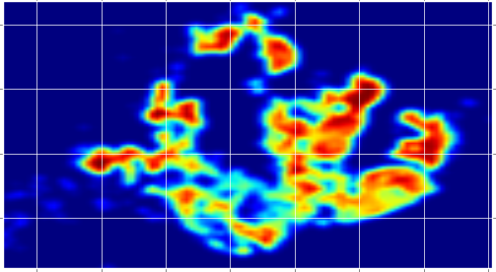
Prompt
Spatial data extracted from postal code information can be used for analysis to understand behaviour in relation to location
Critical segment of participants to be nudged into walking to train station – those between 0.4km and 1.0km away
Relevant information:
postal code of participant’s mailing address
MRT/LRT locations
Heat map of 300,000 participants registered between Aug 2016 and Dec 2016
Notes:
As part of the NSC2 program’s data collection scheme, we have available the postal codes of participants, as indicated by the desired mailing address for receipt of their reward vouchers. To better understand the effectiveness of the program over geographical space, we’ve geocoded participants by their inferred home locations, and tried to draw some conclusions based on justifiable assumptions.
The baseline assumption of this particular analysis is that there is a critical segment of participants whom are most likely to be convinced to walk to their nearest train station, instead of taking a feeder service. These participants are those whom live between 0.4km to 1.0 km to their nearest train station; the majority of those living closer already do walk, and those living more than 1.0km away are considerably less likely to be convinced to walk (Source needed)
The processed datasets used in the analysis may be found in the assets directory. pc_latlon_dd.csv contains the geocoded locations of participant home location and nearest train station, as well as the calculated distance between them.

Slide 3
Questions
What is the current distribution of participants by distance to their nearest train station?
Which areas are prime locations for outreach to encourage walking to the train station?
Notes:
Hence, the questions we should seek to answer through examination of the data, should firstly help us understand the character of the distribution of participants across space, and then help us identify the areas where efforts should be concentrated to encourage walking to the station.

Slide 4
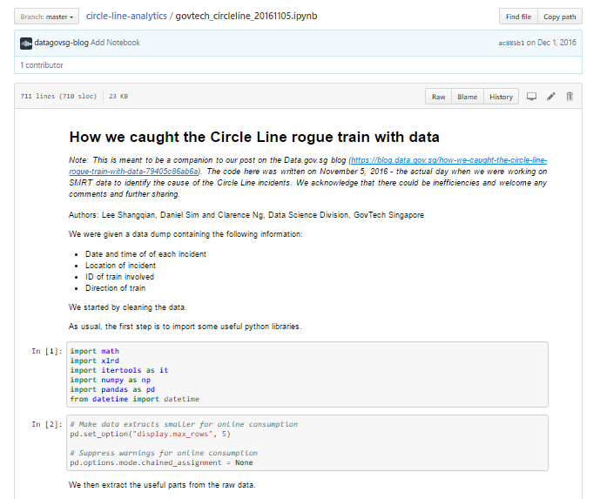
Tools
Jupyter Notebook
Data preparation
Visualization
Clustering
OneMap 2.0 Beta API
Geocoding of postal codes to latlon
Jupyter Notebook as used by GovTech to identify the train causing signalling problems
Notes:
Most of the work done here was done in Jupyter Notebook, written in python. The notebook file is named homeloc_dist.ipynb, in this directory.
Geocoding of the participants’ mailing addresses was also done in python, but using a simple script, written to record the latlons of postal codes to a csv file by calling the API when it is run, but accommodating a break to the script midway without needed to re-geocode already done postal codes. I.e., the results are stored on disk, not on memory.

Slide 5
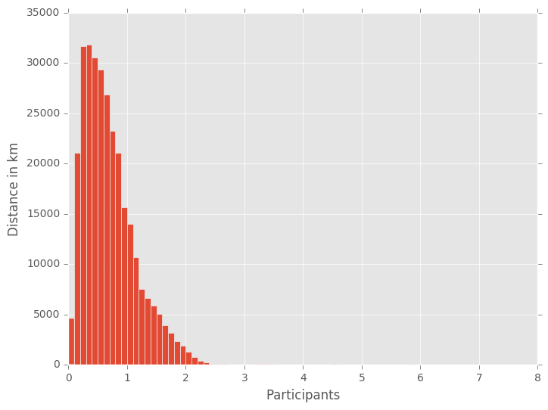
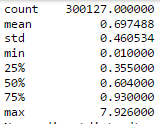
Results – Overall distribution
89.5% of participants’ mailing address successfully geocoded
Assumed that participants with missing postal codes are randomly distributed
Distance follows log-normal distribution
Notes:
Out of 27127 unique postal codes in the participant data, 1748 (6.44%) were unrecognized by OneMAP’s API, either because they were poorly formed(didn’t take the form of a 6-digit number) or because they were invalid postal codes.
Mapping these postal codes back to the actual participants, out of 339121 participants, 38994(11.50%) participants' home locations could not be determined. Some of these are because of the geocoding failure(7949, or 2.35%), but the rest are simply because no postal code was provided(31045, or 9.15%).
For the rest of this analysis, it is assumed that the participants with missing geospatial information can safely be ignored, by assuming that there is no spatial relationship to their propensity to fail to provide a valid postal code.
As for the distribution of participants by distance to nearest train station, we see from the histogram that it resembles a log-normal distribution, which is not unusual, as people can be expected to accumulate nearer to transit nodes.

Slide 6
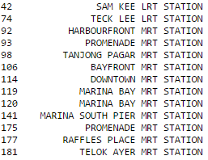
Results – Unrepresented stations
To analyse participants in relation to their nearest train station, we assign them to the train station nearest to them.
Stations with no participants nearby are all in non-residential areas, so it is safe to ignore them as potential focus areas
List of stations with no participants assigned
Notes:
As for train stations, out of the available data, 164 stations are currently operational, whilst the remainder were downtown line stations yet to be opened. From there, we calculate the distance of each participant to their nearest train station for further analysis.
Out of these 164 stations, there were 13 which were not the nearest station to any of the participants. These might potentially be areas to be targeted for outreach, but upon identifying them, it’s clear that they are primarily at non-residential areas.

Slide 7
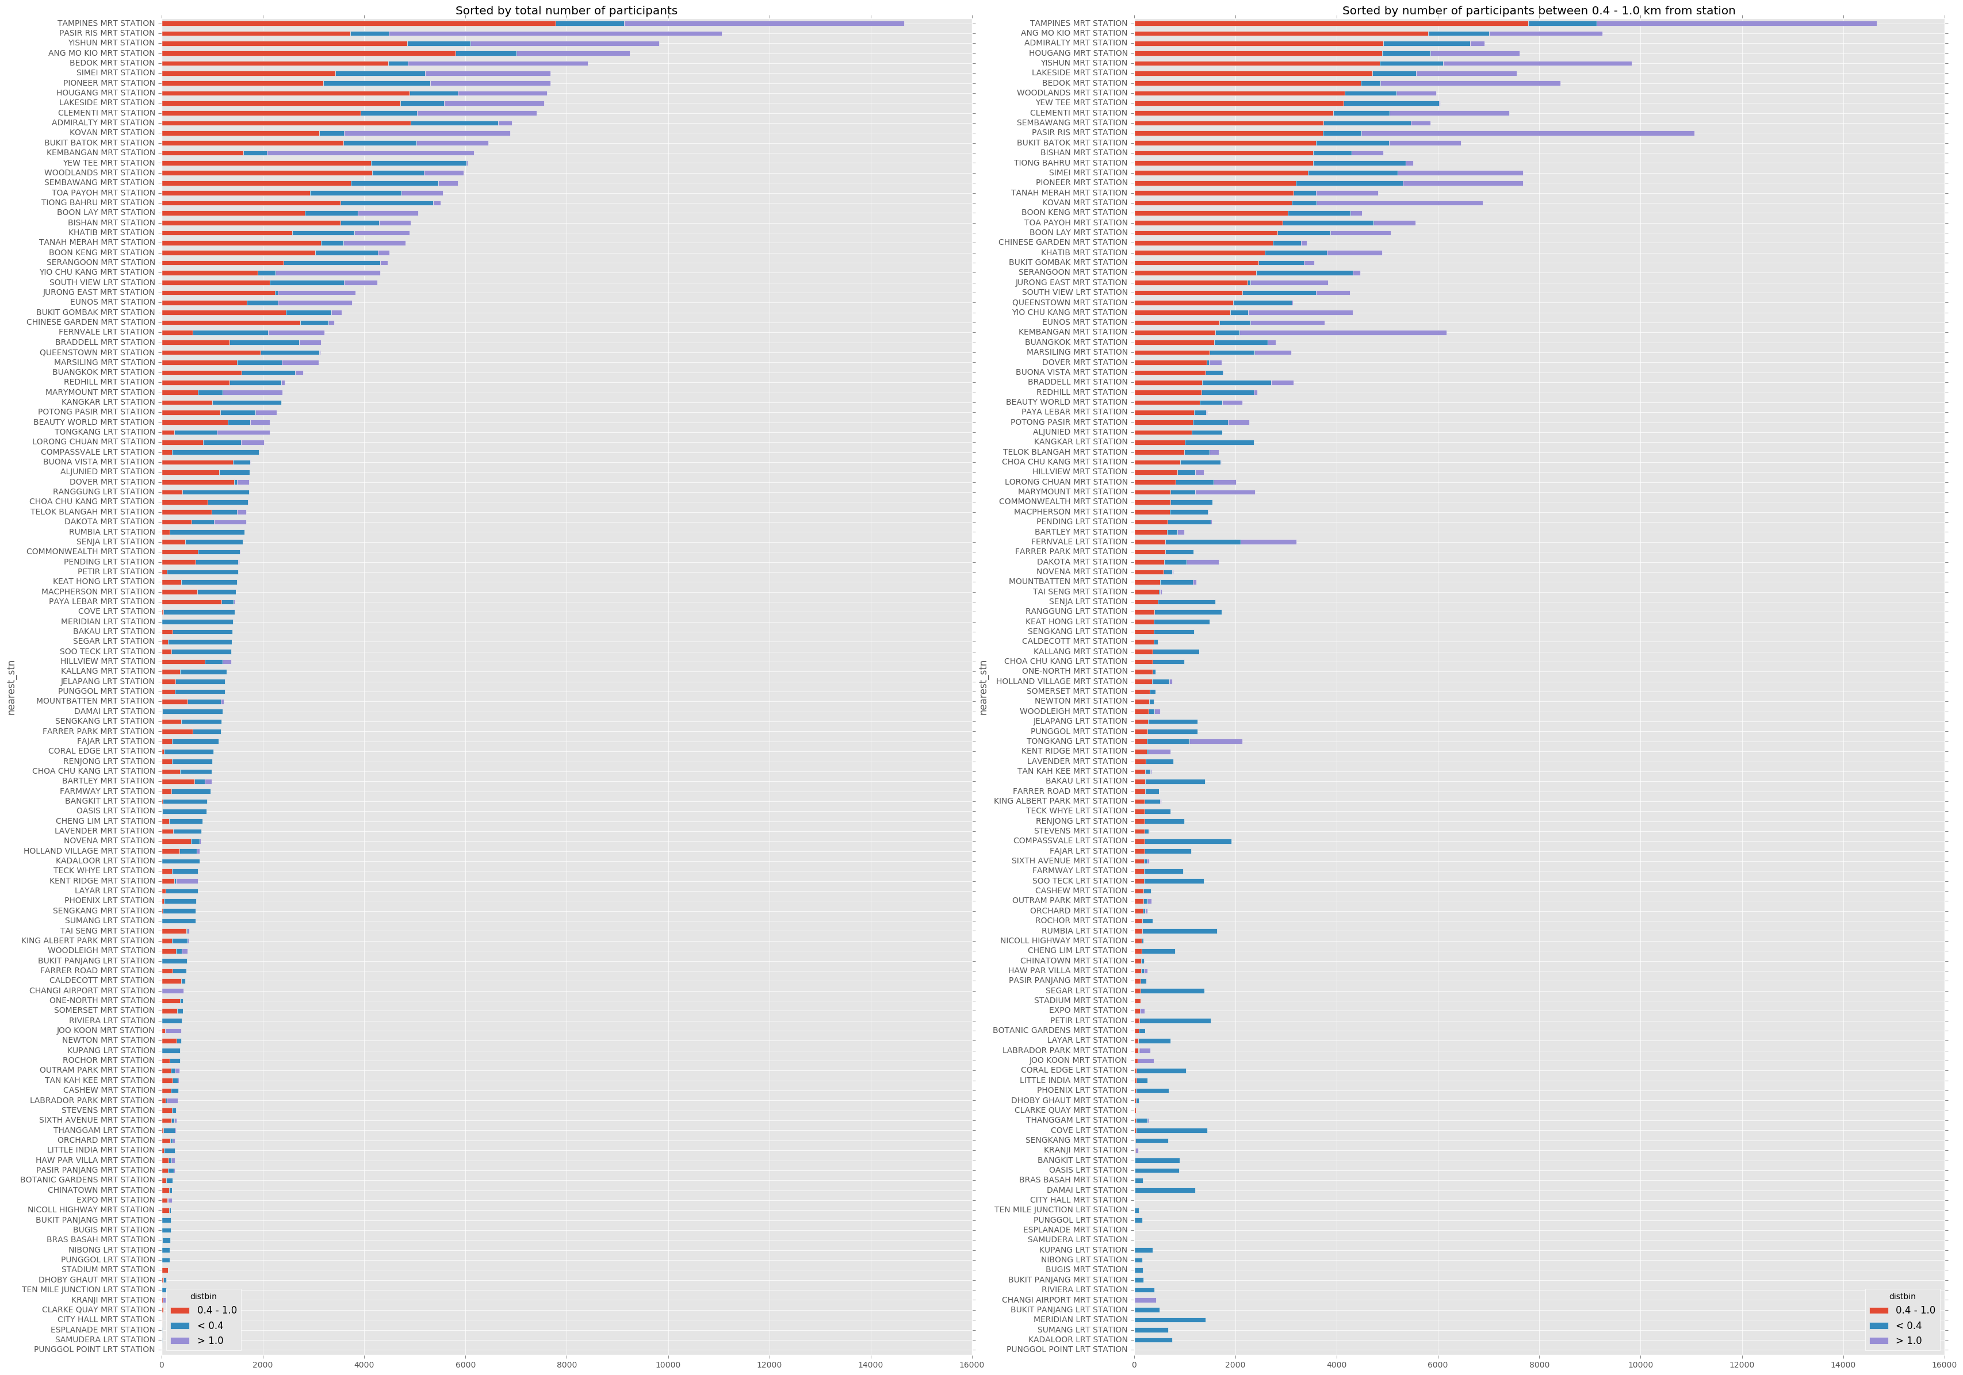
Results - Breakdown
Top 12 stations with the most participants in the critical distance segment
Stations with the most participants are from relatively deep in the heartlands
Observing the splits by distance category, there are stations with relatively different participant distributions by distance. Further spatial analysis and clustering is necessary.
See distance_bins.png for full breakdown
Notes:
Turning our focus to the stations that actually have participants assigned to them, in broad overview we see that the stations with the strongest showings are all pretty deep in the heartlands. These areas also seem to be the places that have the highest residential population, some comparison to that number might be useful, so we’ll continue to explore in that direction.
For the full breakdown of all stations, please refer to distance_bins.png, in the assets directory.

Slide 8
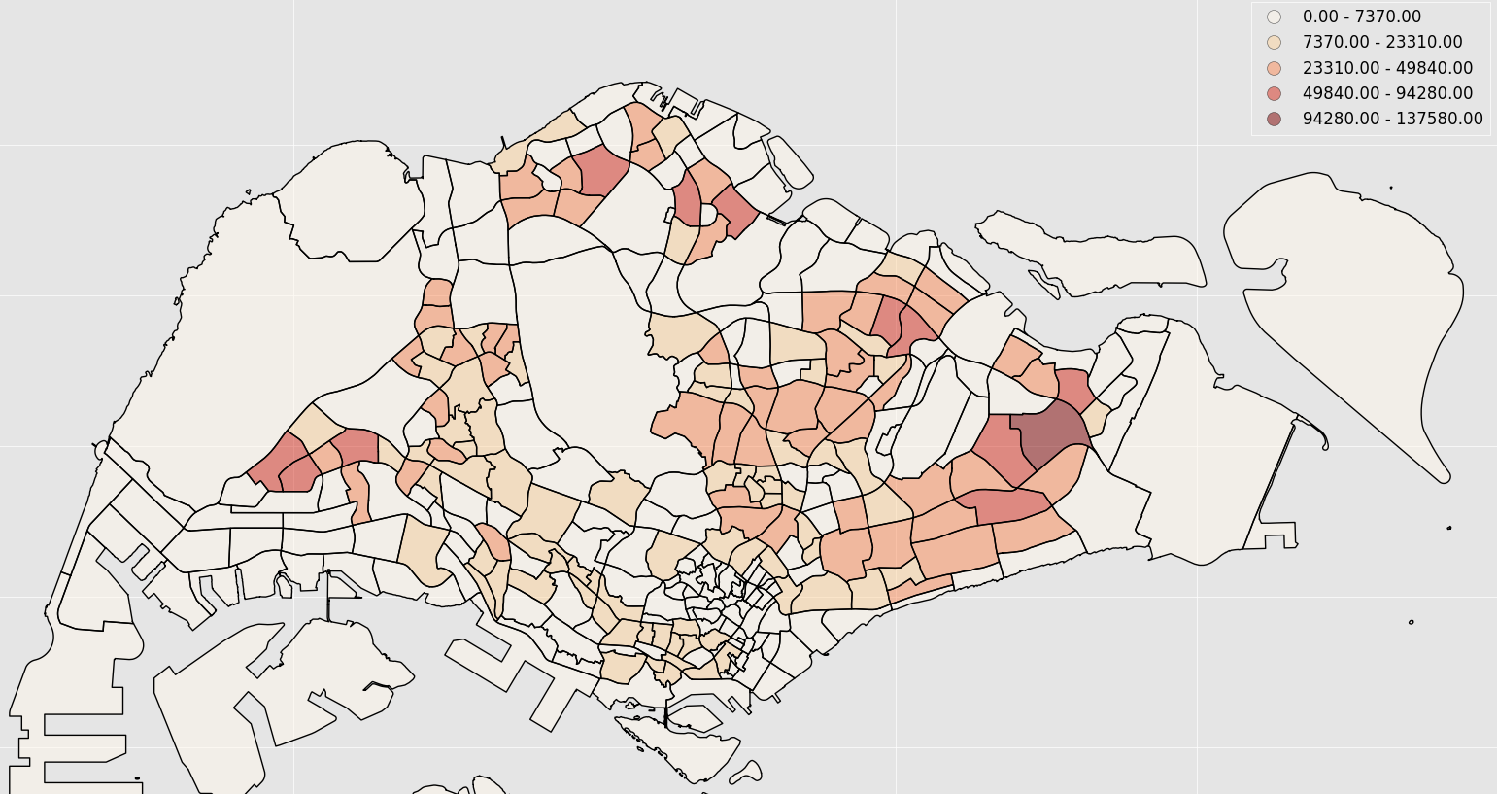
Population distribution
Notes:
Here we see the overall population distribution by URA Subzone, based on MTI’s 2016 census data.

Slide 9
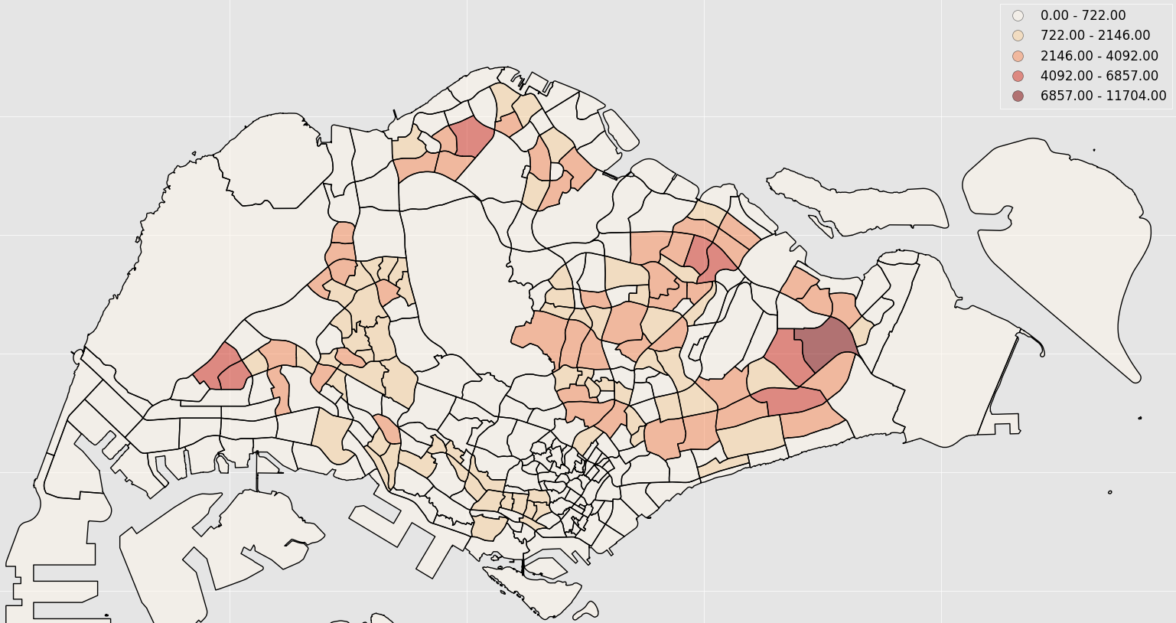
Participant distribution
Notes:
And here we see the participant distribution across the island. Comparing the previous chloropleth map to this one, we’ve confirmed the suspicion that participation is stronger deeper in the hearlands. Participants are clustered more strongly together than the resident population in every area except for the North-West, Central, and South-East areas

Slide 10
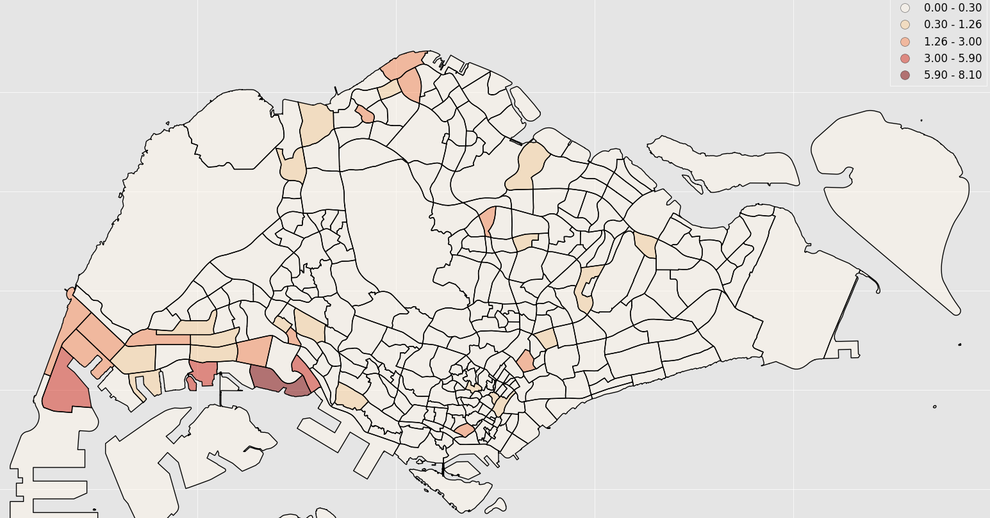
Participant per resident
Not Representative!
Notes:
At this point, it’s tempting to find out participants per resident in each area, to gauge how successful the program was in each subzone, but that would be a misleading direction to take when trying to figure out where to target to reach the most participants whom live between 0.4km to 1.0km to their nearest train station. What we want is the largest capture net, not the best capture ratio per capita. Hence, we should simply use the absolute number of participants in the critical distance segment, and target those areas.
In any case, a cursory look at the data reveals areas where the participation rate far outstrips the census residential population. Given the extent of the surplus, and the location of these areas at the far west and southwest near foreign worker dormitories and shipping yards, we have a good indicator that a good number of participants in the program from these addresses are non-citizens/PRs.

Slide 11
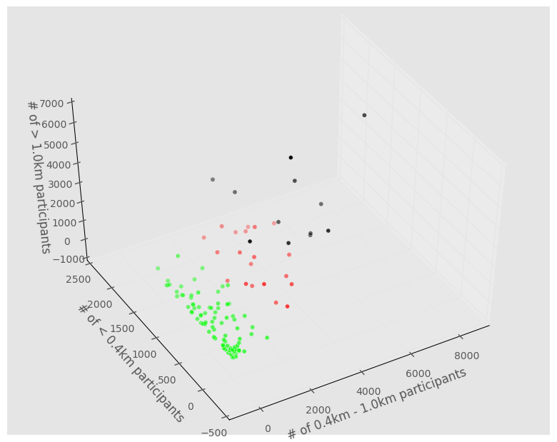
Cluster
Green: Almost all participants within 0.4km
Black: Significant proportion of participants > 1.0km away from train station
Red: Few participants > 1.0km away, whilst still having many > 0.4km away
Notes:
Before we simply choose to target train stations with the highest critical distance participation, it’s worth noticing that the order sorted by critical distance population is quite different from that sorted by total participation. It seems that there are different types of distribution between distance classifications amongst the stations. Hence, it might be worthwhile trying to interpret the typology of stations by the distance to participants.
In this 3D plot, we can see the stations according to the 3 distance bin counts. (Points that are more opaque are closer, those that are more transparent are farther.) Utilizing k-means clustering, k=3 seems to generate the most useful profile interpretation for us:
The green cluster represents stations with very small catchment, with almost all participants being within 0.4km of the station. These are not the best stations to focus on, as they obviously have too few of the critical distance segment of participants.
The black cluster represents stations with very broad catchment, with many participants assigned being more than 1.0km away. Whilst these stations do have a fair number of participants in the critical distance segment, their very wide catchment suggests that targeting those in the critical segment through the station would be less effective due to their relatively smaller representation.
The red cluster represents stations in between the other two, but of note is that the numbers of participants > 1.0km away in the stations in this cluster are much closer to those of the green cluster, than the black cluster. Targeting the critical segment through these stations would hence be considerable more efficient than through the stations in the black cluster.

Slide 12
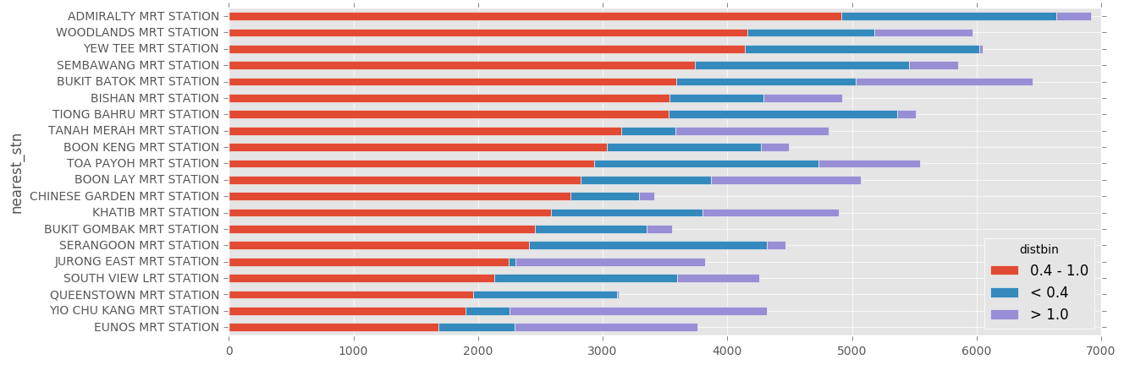
Results – Cluster Profiles Filter
20 stations with the most significant amount of participants within 0.4 – 1.0km of their nearest train station
Notes:
Taking only the stations from the red cluster from the breakdown by distance, sorting by the number of participants in the critical distance segment, we get a the final set of stations which should be the focus for any further initiative to encourage walking to the train station.
Perhaps there is some spatial relation between these points by which we can further consolidate focus?

Slide 13

Results – Cluster Profiles Filter
20 selected stations plotted against participant distribution
Notes:
Plotting them on the map, we can see that the points are fairly evenly spaced, so there is no good way to narrow the focus further by spatial relation. However, we can observe that compared to the plot of current participants, the prescribed focus stations are away from the broader, more even clusters of subzones in the East and Northeast, but instead centred strategically at areas with intermediate participation levels.

Slide 14
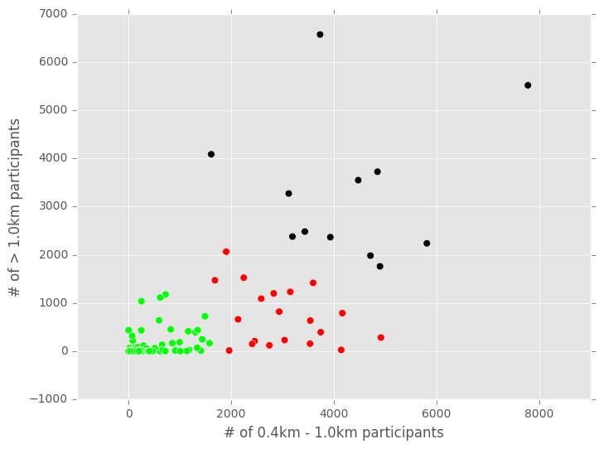
Interpretation
Participation in NSC occurs in clusters amongst participants living in particular regions, most notably around Tampines, Woodlands, and Boon Lay.
As these clusters grow, their radius increases, and the participants within them begin to include even people living far away from their nearest train station.
As participation rates in the centres of these clusters becomes more uniform, and the distance from participants to nearest station more closely resembles a log-normal distribution, we can consider these regions to have reached maximal participation
Cross section of 3d scatter, w/o <0.4km axis
Notes:
As spatial clusters of participants grow within residential regions, the centres of the clusters reach a point where the distribution of distances from these participants to their nearest train station are distributed log-normally, which is indicative of maturity of the program in that area. A condition for reaching this state of maturity is for that region to have potential regions of growth around it, i.e. residents within capture radius who are not yet on the program.
Whilst it is not possible to identify the next regions to target for progression into maturity purely by the absence of participants captured from a far distance, this absence is a necessary condition. By identifying stations exhibiting this absence, and also ruling out stations with very low capture distance by interpreting them to be areas with low residential density, we can find the subset of stations that have the most participants in the critical 0.4km – 1.0km range, but which have not reached the state of maturity where they capture individuals from a great distance. These are the best stations to focus on in terms of encouraging participants to walk to them.

Slide 15
Further work
Comparison of the distribution of participant distances to nearest station, for each station, could be done more easily on a tool like Tableau.
The shape of these distributions might have some correlation to not only the number of participation at that station and nearby stations, but also to their position in the entire network.
If so, this would confirm that residential district planning has implications on the propensity for physical activity, as measured by participation in NSC2, in a far wider area than may be intuitive.
Comparison of this data to growth and ebb of participation over the course of the NSC might also reveal more interesting patterns than can be discerned merely from registration.

